Slide 1


in partnership with
A better offer for the timber frame sector
Commitment to stock
Commitment to performance
Commitment to service
PMH Supplies Ltd. Your local distributor for Ireland
Unit 15 Craigstown Industrial Estate
Randalstown, Co Antrim
Phone 028 9447 9127 Web site PMH Supplies.com

Slide 2
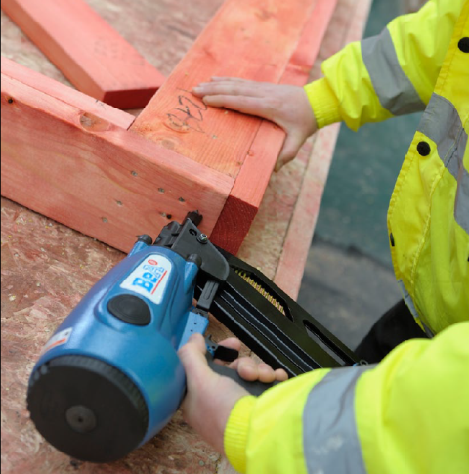
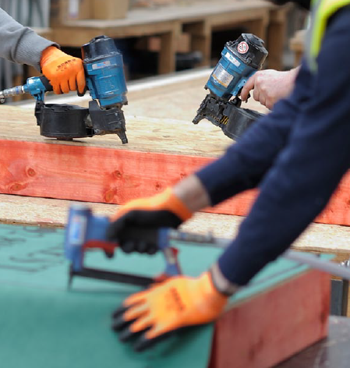
Key Product Offer - Timber Frame House Kits
Factory applications
Main frame | 3.1 x 90 mm screw or ring shank nails 90% strip nail / 10% WW coil
Sub-frames | 3.1 x 90 mm ring shank nails
Timber based panel sheathing | 2.8 x 50 mm ring nails 40% WW / 58% plastic coil / 2% staples
Plasterboard fixing | concave head coil nail or collated drywall screw - pneumatic or electric
MgO + other boards | Issues of damaging board when nailing + corrosion resistance
Breather membrane | 71 series staple - all stainless steel
Wood fibre + other solid insulation | Long nails or staples with pneumatic tools
+ Autotec options for framing + sheathing + insulation
Gas in yards to manufacture longer elements

Slide 3
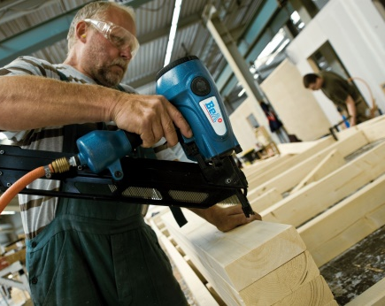
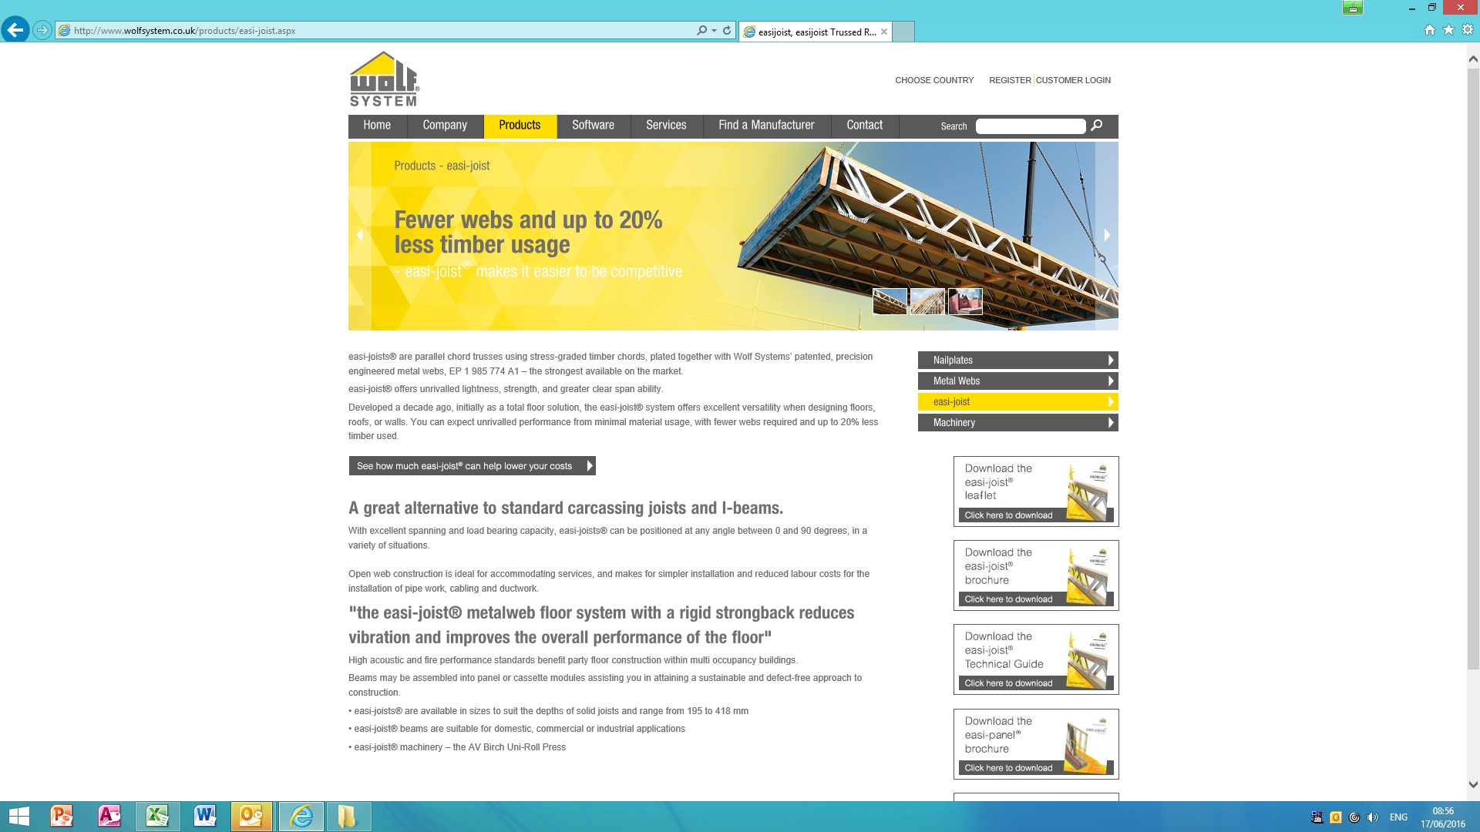
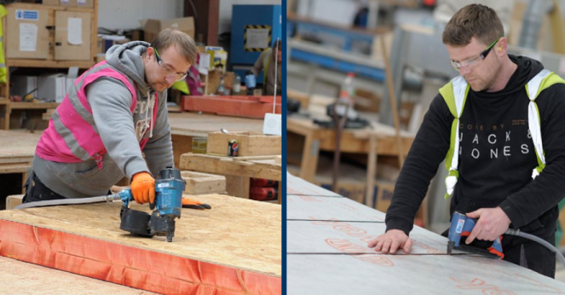
Timber Kit Manufacturers – applications + solutions - offsite
Framing
3.1x90 screw or ring
3.1x90 for sub assemblies
Plastic strip vs paper tape
Floor cassettes
PPN tool for hangers
2.8x50 coil nail for sub-floor
3.1 x 90 ring nail for framing
3.9x55 collated screw for final floor
OSB sheathing – virtually all factories
2.8x50 Coil ring
Wire weld vs plastic coil
Breather membrane + indicator tapes
71/10 – (eq. to ITW 31 series)
Usually stainless
Plus A11 hammer tacker application onsite
MgO sheathing – growing.
Possible reaction between
board + nail. 2.8x50 coil ring
Depth control / large head important
Plasterboard
7mm cup head nails on plastic coil
Coarse thread drywall screws
Removability vs speed
Other
Some light guage stapling for delivery wrapping
Move from open panel vs closed panel – 1st step inserting insulation in factory.

Slide 4
Key Product Offer - Floor + Roof Truss Manufacturers
Growing use of fasteners, including for floor cassettes, roof cassettes + spandrel panels
Truss Layout | Corrugated fasteners / some staples
Framing | Mainly by nail plates, but some strip nails, 3.1x90, 3.1 x 75 and 3.1 x 65
Multiple trusses | BeFix Structural Timber Screws – limited range of wafer head required (8mm preferred for I-Joists, 6mm preferred for metal web joists) + Nails!
Joist + metalwork connections | PPN Gas Nailer + NFP onsite or pneumatic PPN offsite (market is 160 million / year – still 75% by hand) BeFix structural timber screws BeA Connectors
Even though metalwork & screws often fixed onsite - usually supplied with trusses

Slide 5
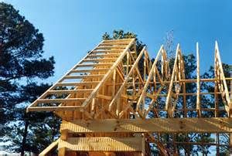
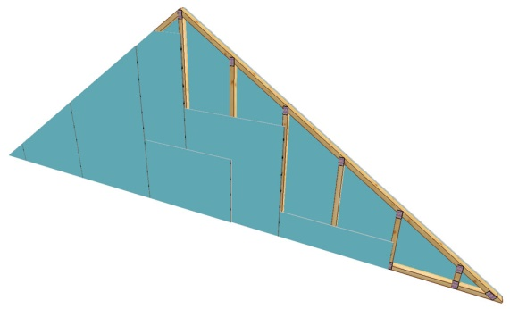
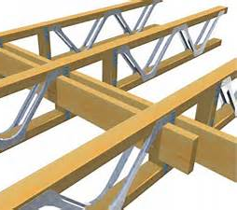
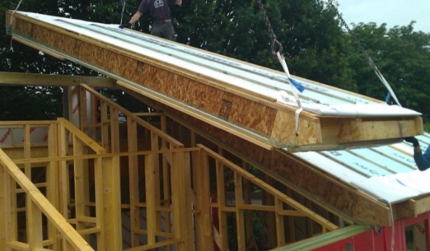
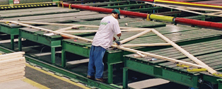
Floor + Roof Truss Manufacturers – applications + solutions - offsite
Gable ladders
Lots of 3.1 x 90 Ring shank nails. Biggest application?
Floor cassettes
PPN tool for hangers
2.8x50 nail for sub-floor
3.1 x 90 nail for framing
4.5x50 screw for final floor
Spandrel panels,
typically double
plasterboard, some
OSB.
Plastic coil cup head nails
3.9x55 Collated coarse drywall screws.
Big time saving using pneumatic tools
Metal web joists
3.1 x 90 nails for minor loads
Corrugated fasteners for setting out
PPN nails for enhanced fire performance
Some require stainless staples for breather membrane
Roof cassettes
3.1 x 90 Ring
shank nails for
framing
2.8x50 Coil nails
For sheathing
Battens may be added in factory or onsite.
Setting out roof trusses
Corrugated
fasteners.
At least for
first in series.
Mainly 25 x 15, some 35 x 25 Maxi

Slide 6
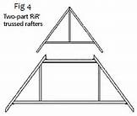
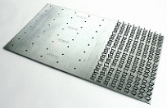
Floor + Roof Truss Manufacturers – applications + solutions – onsite erection
Always important to ask if manufacturer does their own erection / ensures correct fasteners are used by supplying them.
Floor cassettes
3.9x55 Collated screw for final floor
BeFix screws to connect
cassettes together
Field splice plates
Can require
60 x 3.4x36.5 square twist PPN nails in one plate.
Great application
for the BeA R60 !
Roof cassettes
BeFix or nails to connect to main structure
Multiple truss connections
BeFix screws for multiple I-joists/open web floors, e.g. round staircases
Multiple roof trusses typically nailed onsite
Strongbacks
3.1x75 or 90mm
nails
Roof sarking/sheathing
Nailing OSB sheet over trusses, particularly in Scotland. 2.8x50 Coil Nail ornail fuel packs
Bracing
3.1x75 nail fuel packs

Slide 7
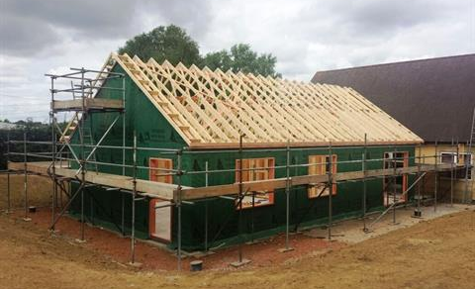
Key Product Offer - Timber Frame House Kits
Onsite / erection applications
Panel connections | Framing Gas Nailer + 3.1 x 90mm NFP, BeFix screws typically 8mm Wafer Head
Subsidiary framing | Framing Gas Nailer + 3.1 x 75mm NFP
Joist + metalwork connections | PPN Gas Nailer + NFP
 | BeFix Structural Timber Screws
 | BeA Connectors
Cladding | Coil nailer or cordless screwgun, HDG/stainless fastener
Roof battening | Framing Gas Nailer + 3.1 x 65mm NFP
Breather membrane | Stainless staples - usually with hammer tacker –A11 S/S
Flooring | Strip screwgun + 3.9x55 screws
Supplying as part of kit ensures correct fasteners used! – Erectors cut corners!

Slide 8
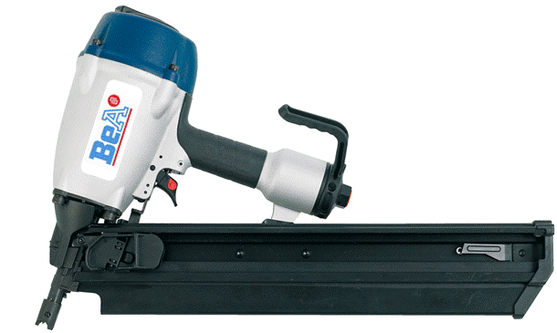
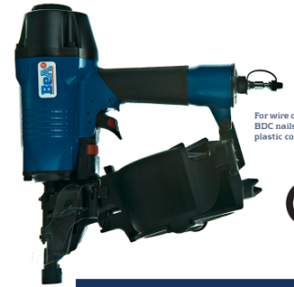

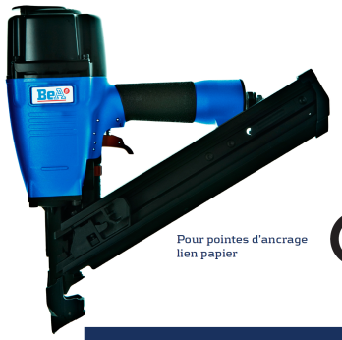
“New” tools
A22/90-F1 Framing Nailer – plastic strip
Lightweight, well balanced, robust, nail lock out
A match for any tool on the market for timber frame
567DC Coil Nailer – plastic or wire weld
Lightweight, well balanced, robust and versatile
Fires 2.8x50 ring or smooth with reduced head diameters
780DC Coil nailer - launch mid-2017
– for 65 / 75mm nails + fixing plasterboard
AN R60-34E Positive Placement Nailer for connectors
Well balanced, robust.
Nose probe more robust than ITW
Safer system than nail point location on competitors
Plenty of factories still do this work by hand
Some factories will only accept single shot, not switchable trigger – we can do this!

Slide 9
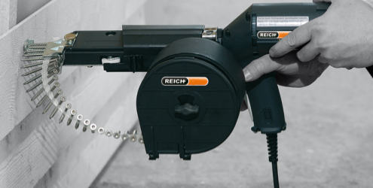
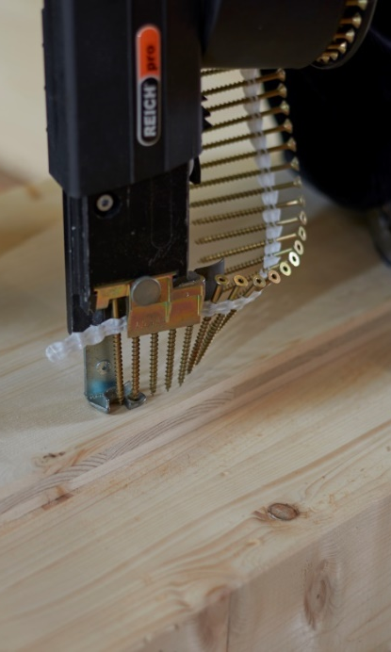
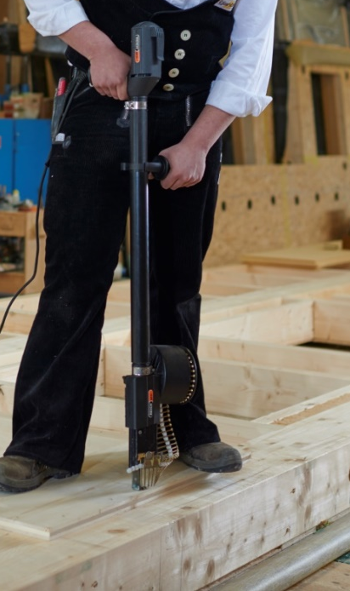
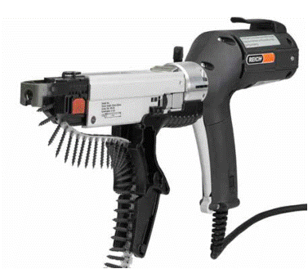
“New” tools
KMR screwguns
KMR3338 for flooring,
125 screw coil, robust, accurate, reliable.
Possible use for panel connections.
Side collation = better guidance
Easy adjustment for screw length
Easy fine tuning of depth of drive
Tx recess screws for best torque
transmission, bit life +fast engagement.
KMR3355 for plasterboard,
Much more robust than any competitor
Uses standard 50 screw flat tape

Slide 10
Tools
Application | Range | Collation | BeA tool
 | Pneumatic
Framing | 50-90mm | 20 plastic strip | A22/90-F1
 | 50-90mm | 34 PL strip | D100-934C
Metalwork | 35-38mm PPN | 34 PL strip | AN R60-34E
Sheathing/ cladding | 35-65mm Ø2.8 | 16 ww coil & plastic coil | 567DC
 | 50-65mm Ø3.1 | 16 ww coil & plastic coil | 903DC
 | 50mm | 155 series | 14/50-763
Breather membrane | 8-10mm
 |  | 22 guage staple, 71 series | 71/14-451A L.Mag
Truss framing | 10-13mm | 25mm wide corrugated fasteners | W15-358
 | Gas
Framing | 50-90mm | 34 PL strip Framing Nailer | D90-660E
Metalwork | 35-38mm | 34 PL strip PPN Nailer | R60-664E
 | Electric, mains
Floor cassettes | 45-80mm | KMR plastic coil screwgun | 3338
Plasterboard | 25-55mm | KMR Flat tape screwgun | 3355
 | Electric, cordless
Floors/cladding | 45-80mm | KM Reich plastic coil screwgun | 3383
Plasterboard | 30-55mm | Flat tape screwgun | SC55/4000

Slide 11
Fasteners
Type | Diameter mm | Lengths mm | Shank + Material
20 plastic strip nail | 3.1 | 75 | Ring 12µm electrogalv
 |  |  | Ring 12µm electrogalv
 |  |  | Screw 12µm electrogalv
34 paper tape nail | 3.35 | 36.5 | PPN Square Twist - hardened
16 ww coil nail | 2.8 | 50 | Smooth 12µm electrogalv
 | 2.8 | 50, 65 | Ring 12µm electrogalv
16 plastic coil | 2.8 | 50 | Smooth 12µm electrogalv
 | 2.8 | 50, 65 | Ring 12µm electrogalv
Plasterboard nail plastic coil | 2.5 | 50, 65 | 5µm electrogalv
Drywall screw coil or strip | 3.8 | 55 | 5µm electrogalv
KMR coil wood screw |  |  | 5µm electrogalv
71 series staple | 0.75x0.60 | 8, 10 | Stainless
A11 series staple | 1.26x0.48 | 8 | Stainless
corrugated fastener | 25mm wide | 12mm
NFP | 3.1 | 90 | Smooth 12µm electrogalv
NFP | 3.1 | 65, 75 | Ring 12µm electrogalv
NFP | 2.9 | 51, 65 | Ring 12µm electrogalv
NFP | 3.35 | 36.5 | PPN Square Twist - hardened
BeFix TK wafer head TX30 | 6 | 70,100,120,160,200 | Electrogalv
BeFix TK wafer head TX40 | 8 | 65,80,100,140,260 | Electrogalv
38 references cover 95%+ of demand

Slide 12
Timber Frame Consumables N Ireland

